Slide 1
Providing The Tools to Build a Strong Foundation

Slide 2
Topics:
Bad habits
Organization
Repetition
Leadership
Communication
Conflict Resolution
Self-Confidence
Things were going to discuss today I Believe are very important in having a strong foundation, but most importantly helping others to build a strong foundation for their futures.

Slide 3
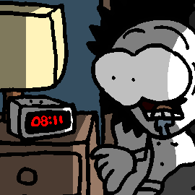
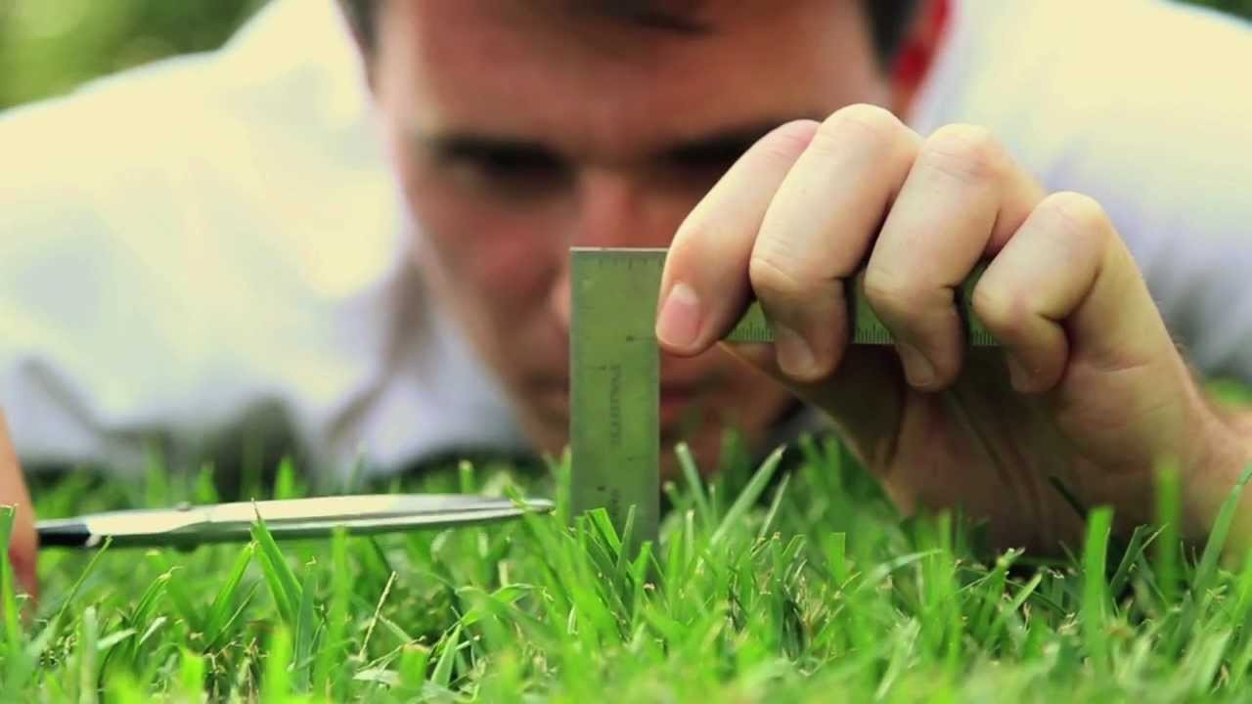
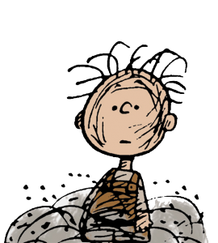
Lifestyle- How one was raised
Shy or soft spoken
Defer things- to put off until later
Tardy – not being on time
Bad Hygiene – doesn’t bother to comb hair
Perfectionism – can only be done one way

Slide 6
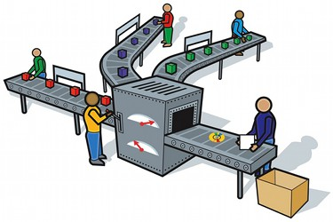
Doing the same thing over and over

Slide 7
Leadership:
Transformation Leader
Changes and transforms people
Ethical Leader
Respecting ethical beliefs and values, being motivated by the dignity and rights of others.
Team Leader
The coach doesn’t stop working just because the team is winning.
Build communication, develop the team, share expectations, create new strategies, improve the function of the team. Support your team.

Slide 8
Three Channels of Communication
Body Language
Hand Gestures
Facial expressions
Verbal
Tone
Para-Verbal
Grunts
Groans
Delivery
Speed

Slide 10
Workplace Conflict
Three categories:
Interest- what people want or need
Rights – host of legally protected rights such as discrimination, Labor Laws, Disability Act
Power – Individuals wanting to impose their beliefs and thoughts on another.

Slide 14
Looking back @ what we have discussed
Bad habits Organization Repetition Leadership Communication Conflict Resolution Self-Confidence

Slide 15
What can we do to help students?

Slide 16
Remember
Student at one time, Give back
Be enthusiastic and passionate about the field of study
Include them in the lecture
Learning Styles (visual, auditory, Read, write)
Association (Instrument & Spelling)
Be the change (build them up not break them down)

Slide 17
Building Strong Foundations for Students
Teach them
Organization
Repetition
Communication
Conflict Resolution
Teamwork
Most important to Believe in themselves

